Slide 1
Introduction to compiling
Chapter-1

Slide 2
Phases of a compiler
A compiler operates in phases.
A phase is a logically interrelated operation that takes source program in one representation and produces output in another representation.
There are two phases of compilation.
Analysis (Machine Independent/Language Dependent)
Synthesis(Machine Dependent/Language Independent)

Slide 3
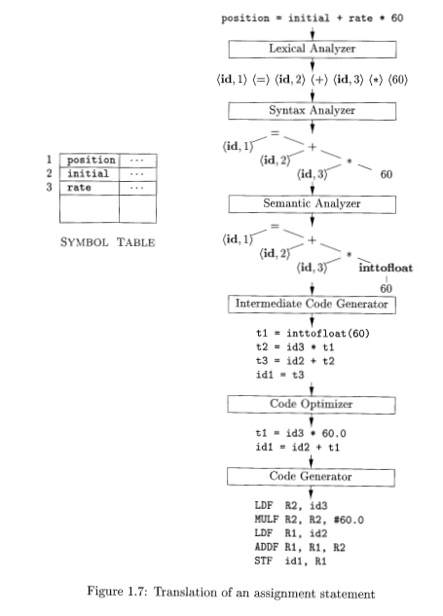

Slide 4
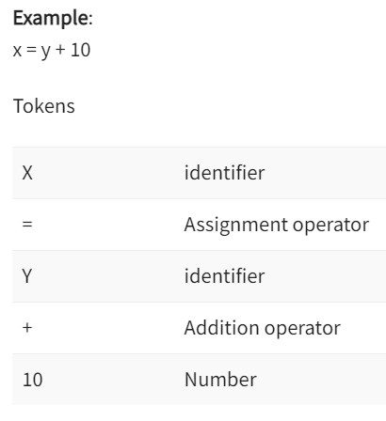
PHASE 1: Lexical Analyzer (SCANNER)
Lexical Analysis is the first phase when compiler scans the source code. This process can be left to right, character by character, and group these characters into tokens.
Here, the character stream from the source program is grouped in meaningful sequences by identifying the tokens. It makes the entry of the corresponding tickets into the symbol table and passes that token to next phase.
The primary functions of this phase are:
Identify the lexical units in a source code
Classify lexical units into classes like constants, reserved words, and enter them in different tables. It will Ignore comments in the source program
Identify token which is not a part of the language

Slide 5
Phase 2: Syntax analysis
Syntax analysis is all about discovering structure in code. It determines whether or not a text follows the expected format.
The main aim of this phase is to make sure that the source code was written by the programmer is correct or not.
Syntax analysis is based on the rules based on the specific programing language by constructing the parse tree with the help of tokens.
It also determines the structure of source language and grammar or syntax of the language.
Here, is a list of tasks performed in this phase:
Obtain tokens from the lexical analyzer
Checks if the expression is syntactically correct or not
Report all syntax errors
Construct a hierarchical structure which is known as a parse tree

Slide 6
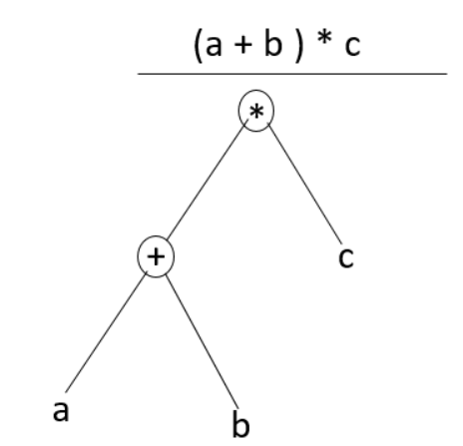
Any identifier/number is an expression If x is an identifier and y+10 is an expression, then x= y+10 is a statement. Consider parse tree for the following example:
(a+b)*c
In Parse Tree
Interior node: record with an operator field and two fields for children
Leaf: records with 2/more fields; one for token and other information about the token
Ensure that the components of the program fit together meaningfully
Gathers type information and checks for type compatibility
Checks operands are permitted by the source language

Slide 7
Phase 3: semantic analysis
Semantic analysis checks the semantic consistency of the code. It uses the syntax tree of the previous phase along with the symbol table to verify that the given source code is semantically consistent. It also checks whether the code is conveying an appropriate meaning.
Semantic Analyzer will check for Type mismatches, incompatible operands, a function called with improper arguments, an undeclared variable, etc.
Functions of Semantic analyses phase are:
Helps you to store type information gathered and save it in symbol table or syntax tree
Allows you to perform type checking
In the case of type mismatch, where there are no exact type correction rules which satisfy the desired operation a semantic error is shown
Collects type information and checks for type compatibility
Checks if the source language permits the operands or not

Slide 8
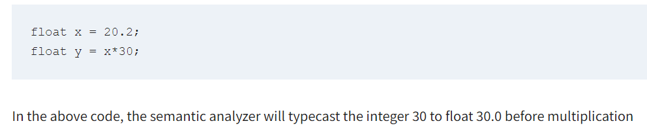

Slide 9
Phase 4: Intermediate code generation
Once the semantic analysis phase is over the compiler, generates intermediate code for the target machine. It represents a program for some abstract machine.
Intermediate code is between the high-level and machine level language.
This intermediate code needs to be generated in such a manner that makes it easy to translate it into the target machine code.
Functions on Intermediate Code generation:
It should be generated from the semantic representation of the source program
Holds the values computed during the process of translation
Helps you to translate the intermediate code into target language
Allows you to maintain precedence ordering of the source language
It holds the correct number of operands of the instruction

Slide 10
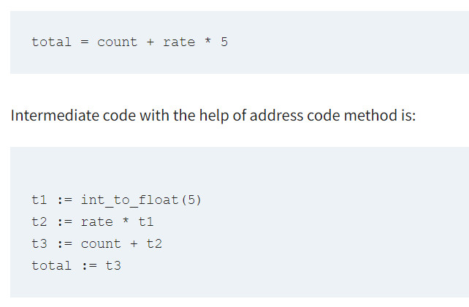

Slide 11
Phase 5: code optimization
The next phase of is code optimization or Intermediate code.
This phase removes unnecessary code line and arranges the sequence of statements to speed up the execution of the program without wasting resources.
The main goal of this phase is to improve on the intermediate code to generate a code that runs faster and occupies less space.
The primary functions of this phase are:
It helps you to establish a trade-off between execution and compilation speed
Improves the running time of the target program
Generates streamlined code still in intermediate representation
Removing unreachable code and getting rid of unused variables
Removing statements which are not altered from the loop

Slide 12
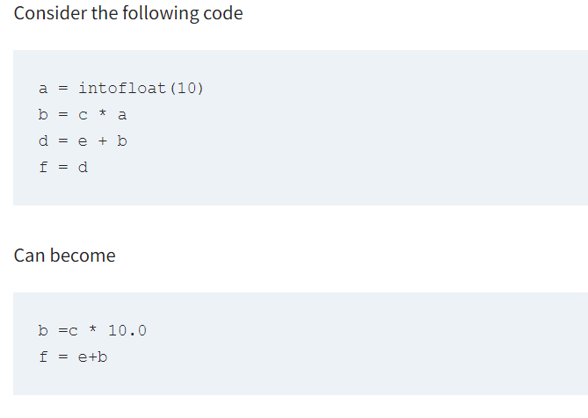

Slide 13
Phase 6: code generation
Code generation is the last and final phase of a compiler.
It gets inputs from code optimization phases and produces the page code or object code as a result.
The objective of this phase is to allocate storage and generate relocatable machine code.
It also allocates memory locations for the variable.
The instructions in the intermediate code are converted into machine instructions.
This phase coverts the optimize or intermediate code into the target language. The target language is the machine code.
Therefore, all the memory locations and registers are also selected and allotted during this phase.
The code generated by this phase is executed to take inputs and generate expected outputs.

Slide 14
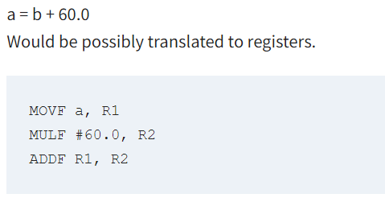

Slide 15
Symbol table management
A symbol table contains a record for each identifier with fields for the attributes of the identifier.
This component makes it easier for the compiler to search the identifier record and retrieve it quickly.
The symbol table also helps you for the scope management.
The symbol table and error handler interact with all the phases and symbol table update correspondingly.

Slide 16
Error handler
In the compiler design, compile-time error may occur in all the below-given phases:
Lexical analyzer: Wrongly spelled tokens, exceeding limits, illegal characters.
Syntax analyzer: Missing parenthesis, wrong operator, missing operator.
Sematic analyzer: Type error, undeclared variables, multiple declared variables.
Intermediate code generator: Mismatched operands for an operator.
Code Optimizer: When the statement is not reachable.
Code Generator: When the memory is full or proper registers are not allocated
Most common errors are invalid character sequence in scanning, invalid token sequences in type, scope error, and parsing in semantic analysis.
The error may be encountered in any of the above phases.
After finding errors, the phase needs to deal with the errors to continue with the compilation process. These errors need to be reported to the error handler which handles the error to perform the compilation process. Generally, the errors are reported in the form of message.

Slide 17
Compiler pass
A Compiler pass refers to the traversal of a compiler through the entire program.
Compiler pass are two types:
Single Pass Compiler, and
Two Pass Compiler or Multi Pass Compiler.

Slide 18
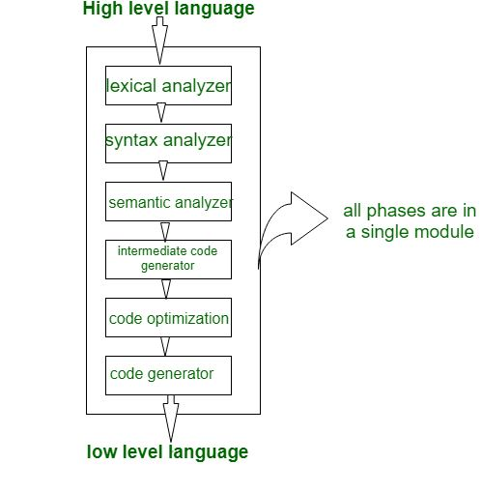
One/single pass compiler
If we combine or group all the phases of compiler design in a single module known as single pass compiler.
In the diagram there are all 6 phases are grouped in a single module, some points of single pass compiler is as:
A one pass/single pass compiler is that type of compiler that passes through the part of each compilation unit exactly once.
Single pass compiler is faster and smaller than the multi pass compiler.
As a disadvantage of single pass compiler is that it is less efficient in comparison with multi-pass compiler.
Single pass compiler is one that processes the input exactly once, so going directly from lexical analysis to code generator, and then going back for the next read.

Slide 19
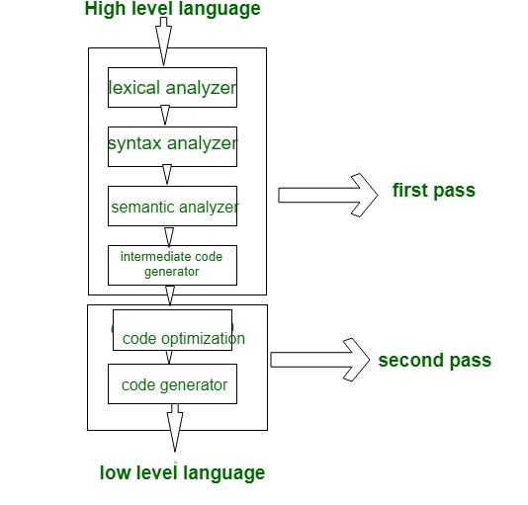
Two pass or Multi-pass compiler
A Two pass/multi-pass Compiler is a type of compiler that processes the source code or abstract syntax tree of a program multiple times.
In multi-pass Compiler we divide phases in two pass as:
First pass
Second pass

Slide 20
First pass
It is referred as
Front end
Analytic part
Platform independent
In first pass,
The includes phases are as Lexical analyzer, syntax analyzer, semantic analyzer, intermediate code generator are work as front end,
analytic part means all phases analyze the High level language and convert them three address code.
first pass is platform independent because the output of first pass is as three address code which is useful for every system and the requirement is to change the code optimization and code generator phase which are comes to the second pass.

Slide 21
Second pass
It is referred as
Back end
Synthesis Part
Platform Dependent
In second Pass,
the included phases are as Code optimization and Code generator are work as back end and the synthesis part refers to taking input as three address code,
convert them into Low level language/assembly language, and
second pass is platform dependent because final stage of a typical compiler converts the intermediate representation of program into an executable set of instructions which is dependent on the system

Slide 22
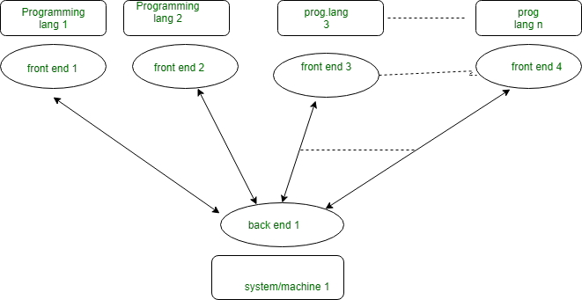
Problem solvable with multi-pass compiler
With multi-pass Compiler we can solve these 2 basic problems:
If we want to design a compiler for different programming language for same machine. In this case for each programming language there is requirement of making Front end/first pass for each of them and only one Back end/second pass as:

Slide 23
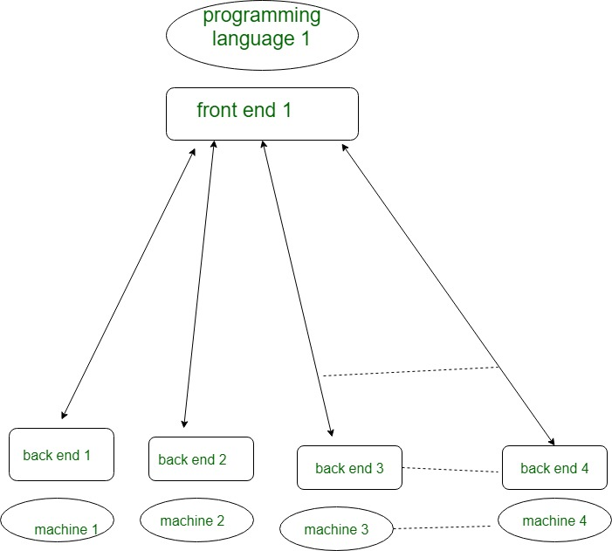
Problem solvable with multi-pass compiler
If we want to design a compiler for same programming language for different machine/system. In this case we make different Back end for different Machine/system and make only one Front end for same programming language as:

Slide 24
Single PASS VS MULTI-PASS Compiler
 | Single Pass Compiler | Multi-Pass Compiler
Speed | Fast | Slow
Memory | More | Less
Time | Less | More
Portability | No | Yes

Slide 25
Lexical analysis
Chapter-3 (Part 1)

Slide 26
Lexical analysis
Lexical Analysis is the very first phase in the compiler designing.
A Lexer takes the modified source code which is written in the form of sentences .
In other words, it helps you to convert a sequence of characters into a sequence of tokens.
The lexical analyzer breaks this syntax into a series of tokens. It removes any extra space or comment written in the source code.
Programs that perform Lexical Analysis in compiler design are called lexical analyzers or lexers.
A lexer contains tokenizer or scanner.
If the lexical analyzer detects that the token is invalid, it generates an error.
The role of Lexical Analyzer in compiler design is to read character streams from the source code, check for legal tokens, and pass the data to the syntax analyzer when it demands.

Slide 27
BASIC TERMINOLOGIES
A token is a pair consisting of a token name and an optional attribute value.
The token name is an abstract symbol representing a kind of lexical unit, e.g., a particular keyword, or a sequence of input characters denoting an identifier.
The token names are the input symbols that the parser processes.
In what follows, we shall generally write the name of a token in boldface. We will often refer to a token by its token name.
A pattern is a description of the form that the lexemes of a token may take [ or match].
In the case of a keyword as a token, the pattern is just the sequence of characters that form the keyword.
For identifiers and some other tokens, the pattern is a more complex structure that is matched by many strings

Slide 28
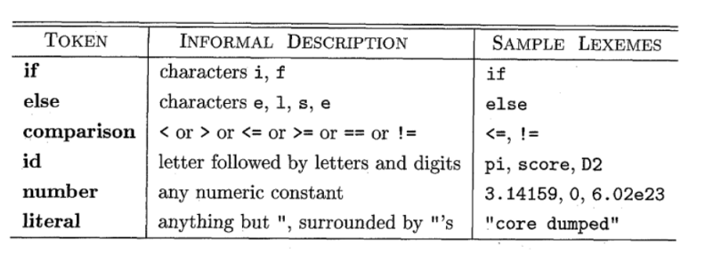
Examples of tokens

Slide 29
Basic terminologies (contd.)
A lexeme is a sequence of characters in the source program that matches the pattern for a token and is identified by the lexical analyzer as an instance of that token.
In the following C language statement ,
printf (“Total = %d\n”, score) ;
both printf and score are lexemes matching the pattern for token id, and “Total = %d\n” is a lexeme matching literal [or string].

Slide 30
When more than one pattern matches a lexeme, the lexical analyzer must provide additional information about the particular lexeme.
Example: pattern num matches 0 and 1. It is essential for the code generator to know what string was actually matched.
The lexical analyzer collects information about tokens into their associated attributes.
In practice: A token has usually only a single attribute - a pointer to the symbol-table entry in which the information about the token is kept such as: the lexeme, the line number on which it was first seen, etc.

Slide 31
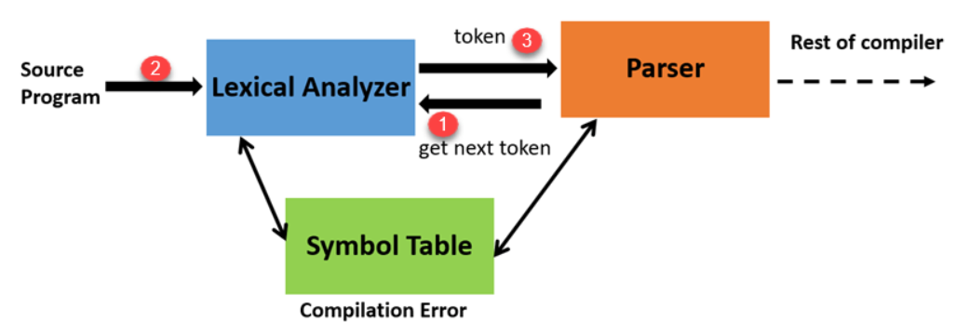
Lexical analyser architecture
“Get next token” is a command which is sent from the parser to the lexical analyzer.
On receiving this command, the lexical analyzer scans the input until it finds the next token.
It returns the token to Parser.
Lexical Analyzer skips whitespaces and comments while creating these tokens. If any error is present, then Lexical analyzer will correlate that error with the source file and line number.

Slide 32
Roles of lexical analyzer
Lexical analyzer performs below given tasks:
Helps to identify token into the symbol table
Removes white spaces and comments from the source program
Correlates error messages with the source program
Helps you to expands the macros if it is found in the source program
Read input characters from the source program

Slide 33
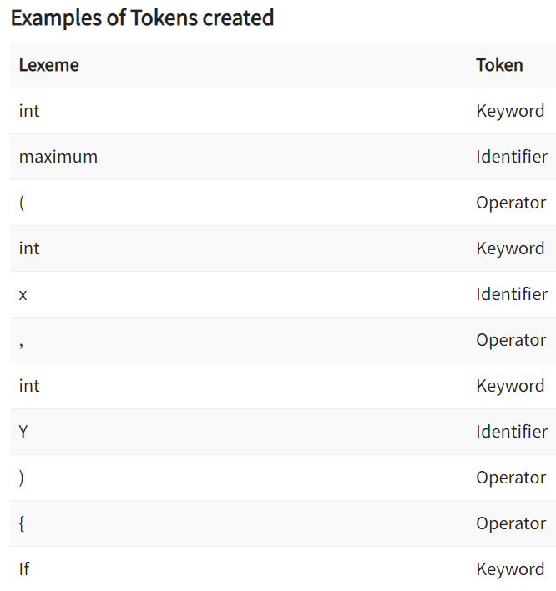
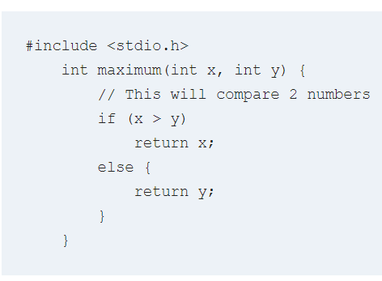
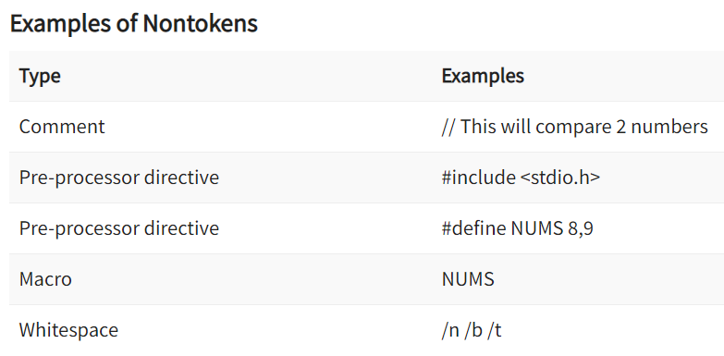
Example of LA, tokens & non-tokens

Slide 34
Lexical errors
A character sequence which is not possible to scan into any valid token is a lexical error.
Important facts about the lexical error:
Lexical errors are not very common, but it should be managed by a scanner
Misspelling of identifiers, operators, keyword are considered as lexical errors
Generally, a lexical error is caused by the appearance of some illegal character, mostly at the beginning of a token.

Slide 35
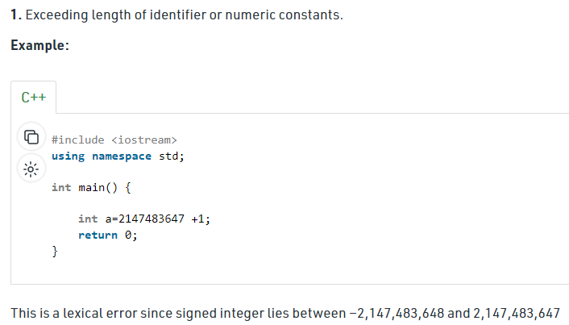
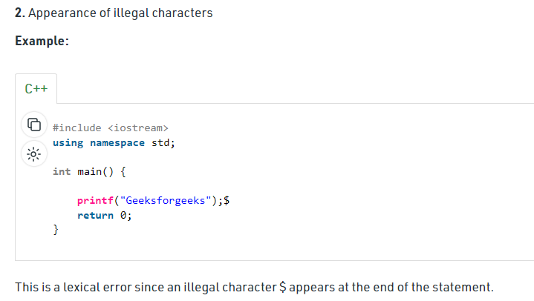
Lexical errors (examples)

Slide 36
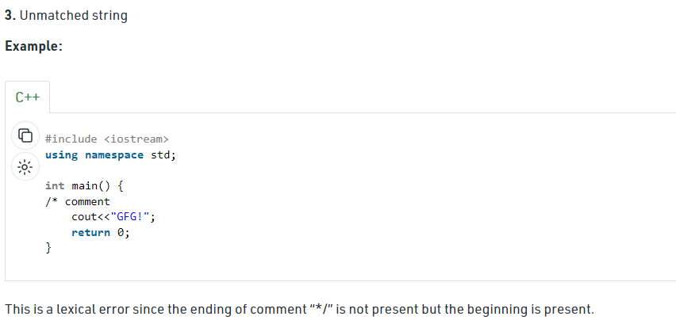
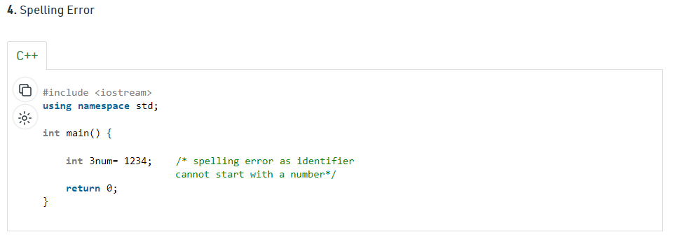

Slide 37
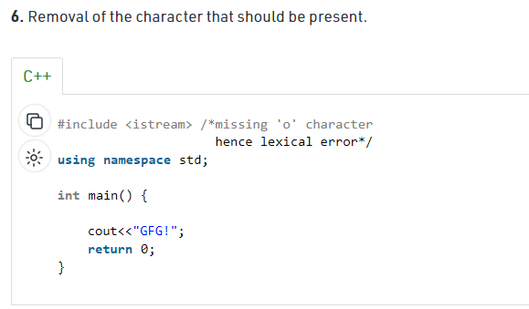
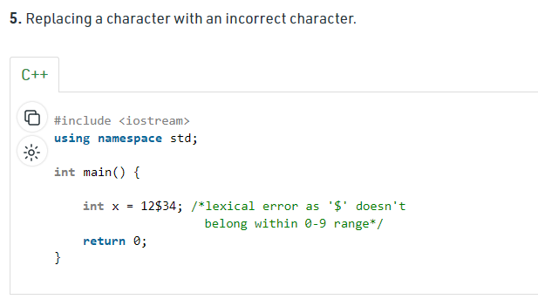
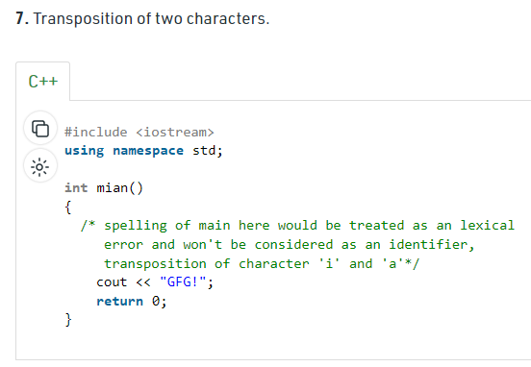

Slide 38
Error recovery in lexical analyzer
Here, are a few most common error recovery techniques:
Removes one character from the remaining input
In the panic mode, the successive characters are always ignored until we reach a well-formed token
By inserting the missing character into the remaining input
Replace a character with another character
Transpose two serial characters

Slide 39
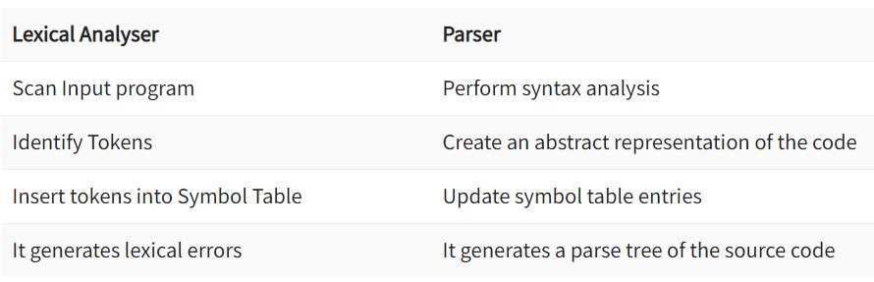
Lexical analyzer vs parser

Slide 40
Stages of lexical analyzer
Scanner: It segments the input string into syntactic units called lexemes and categorizes these into token classes.
Based on a finite state machine.
If it lands on an accepting state, it takes note of the type and position of the acceptance, and continues.
Sometimes it lands on a "dead state," which is a non-accepting state.
When the lexical analyzer lands on the dead state, it is done.
The last accepting state is the one that represent the type and length of the longest valid lexeme.
The "extra" non valid character should be "returned" to the input buffer.

Slide 41
Stages of lexical analyzer (contd.)
Evaluator: It converts lexemes into processed values.
Goes over the characters of the lexeme to produce a value.
The lexeme’s type combined with its value is what properly constitutes a token, which can be given to a parser.
Some tokens such as parentheses do not really have values, and so the evaluator function for these can return nothing.
The evaluators for integers, identifiers, and strings can be considerably more complex.
Sometimes evaluators can suppress a lexeme entirely, concealing it from the parser, which is useful for whitespace and comments.

Slide 42
THANK YOU

